Slide 1

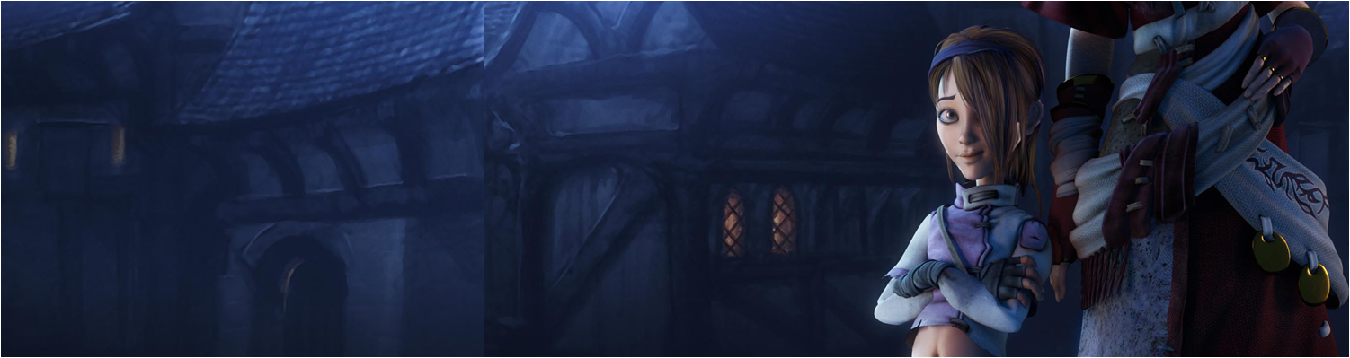

Lecture 4: Making Platform Games pt IV
GAM150: Game Programming Essentials
BA Game Development

Slide 2
Last time:
Jamie’s Lecture
My last lecture:
Platforms, Hazards, traps & death
Version Control
Any issues to report?

Slide 3
Today’s session:
Animating and choreographing activities
Break
Unity UI
Prototypes into standalone games
Assignment Q&A

Slide 4
Animating and choreographing activities

Slide 5
Animating and choreographing activities
Last time, we looked at using scripts to drive movement
Moving platforms
Hazard & trap behaviours
Script is one method for this:
Benefits:
Simple to get working
Easy to copy behaviours from one instance to another
Cons:
Need to make scripts that are re-usable (move values into inspector)
Can be fiddly to make things move ‘right’ (accelerate, pause)
Complex behaviour is difficult to script
Difficult to choreograph multiple items together

Slide 6
Animating and choreographing activities
Another method is to use animation (in some form or other)
Unity has 3 approaches:
Animation components
Animator (mecanim)
Timeline
All are geared around keyframed timelines

Slide 7
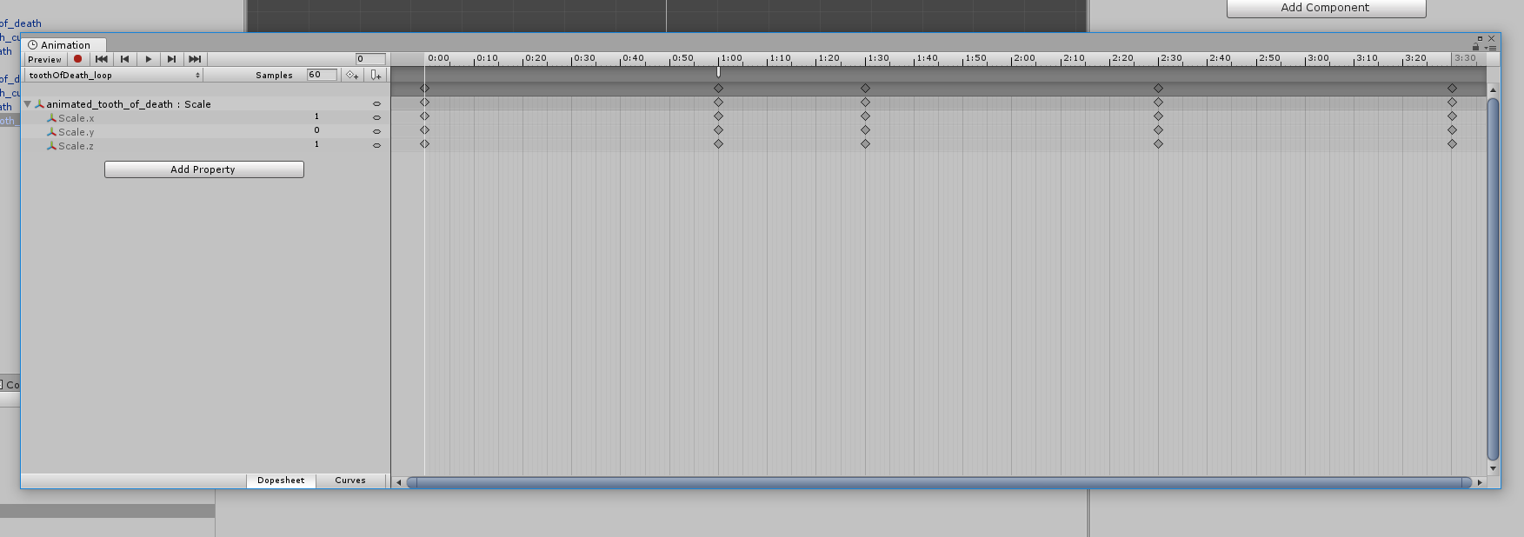
Animating and choreographing activities
All are geared around keyframed timelines
Most components / data in Unity can be animated
[Window->Animation->Animation]

Slide 8
Animating and choreographing activities
All are geared around keyframed timelines
By key frame:
we can set target values to occur on certain frames in a timeline
The animation system will interpolate (lerp) between values over time (just like what we did in lecture 2)
So, we can set values and the animation system will do the heavy lifting for us
‘Values’: position, scale, rotation, colour etc etc
Much of unity can be exposed to animations and being animated
We can also set events

Slide 9
Animating and choreographing activities
All are geared around keyframed timelines
Dopesheet or Curves
Generally, use the dopesheet for animating between keyframes with values
Animators will prefer curves as it gives more control over animations
However, this is usually problematic for programmers / designers
Particularly when you need to animate to specific maximum/minimum values

Slide 10
Animating and choreographing activities
All are geared around keyframed timelines
Time & ticks
Animator window uses time for setting keyframes
Everything works of seconds
This is nice as it makes sense and you can (fairly) easily choreograph how you want things to work
For some reason, it also uses frames to set replay speed (in samples)
‘normal’ behaviour is 60 samples per second
Making this value lower will make the animations play slower
Making this value higher will make the animations play faster
Generally, don’t touch it, but there may be situations when it makes sense to (no, I can’t think of any off the top of my head either).

Slide 11
Animating and choreographing activities
Unity has 3 approaches and they have slightly different uses:
Animation components
For animating a single game object, though can do multiple objects too
For animation events
For multiple animations
Animator (Mecanim)
For more complex animation systems
For blending multiple animations & controlling skeletal weighting and procedural animation control
We will look at this later in the module
Timeline
For choreographing multiple game objects
Typically for making in-game animating sequences
We wont look at this explicitly in the module, but its functionality is very close to that of the animation component

Slide 12
Animating and choreographing activities
Moving platforms revisited

Slide 13
Animating and choreographing activities
Moving platforms revisited
Last time, we looked at making platforms move through the power of scripting
For the programmers, this was the best thing ever
For the designers, this was an introduction to a world of pain
I did mention that making things move ‘nicely’ would cause a lot of programming niggles
By ‘nicely’, I mean platforms that don’t move uniformly over time (they pause, accelerate, move in X & Y etc)
i.e. They have character.

Slide 14
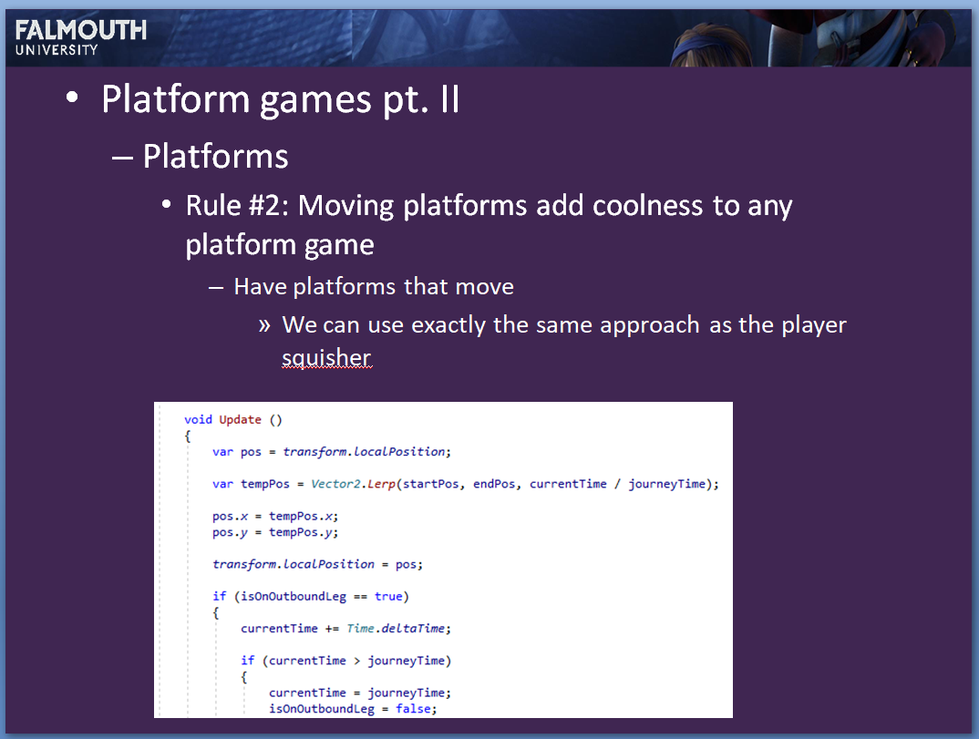
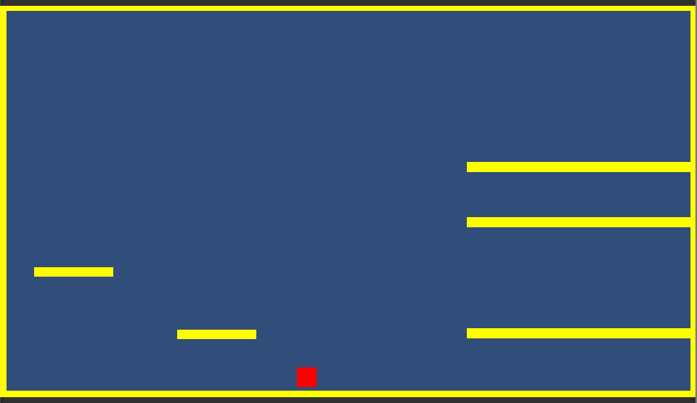
Animating and choreographing activities
Moving platforms revisited
01. Moving Platforms
This is week 2’s 06. Moving platforms
2 platforms that move using scripts

Slide 15
Animating and choreographing activities
Moving platforms revisited
02. Animated Platforms
Let’s remove the nasty script and replace it with animations

Slide 16
Animating and choreographing activities
Moving platforms revisited
02. Animated Platforms
Let’s remove the nasty script and replace it with animations
To do this:
Remove the movingplatform script from each moving_platform
Add an animation component
Open the animation window
Add a new animation called platform_horizontal
Add the moving platform.transform.position as a property to the animation
Turn on record and use your skill and judgement to create keyframes for the platform.
Find the animation and set its wrap mode to ‘ping pong’ for a nice round trip animation
Set the animation in the platform’s animation box
Press run in the game

Slide 17
Animating and choreographing activities
Moving platforms revisited
02. Animated Platforms
Let’s remove the nasty script and replace it with animations
To alter the speed of the platform, either
Make the time between the keyframes longer
Reduce the number of samples

Slide 18
Animating and choreographing activities
Moving platforms revisited
03. Animated Platforms
Now we can start having fun
We can add more keyframes to adjust the feel of movement
Move to one end
Stop for a while
Move back to the start
Stop for a while
Either ping pong or loop the animation
If you loop it, make sure the platform goes back to its starting position, else it will glitch

Slide 19
Animating and choreographing activities
Moving platforms revisited
03. Animated Platforms
Now we can start having fun
The key thing to remember, is that the animation will always lerp between values
Therefore, if you don’t want something to move for a while
Set two keyframes with the same value
Otherwise, the animation will lerp between values

Slide 20
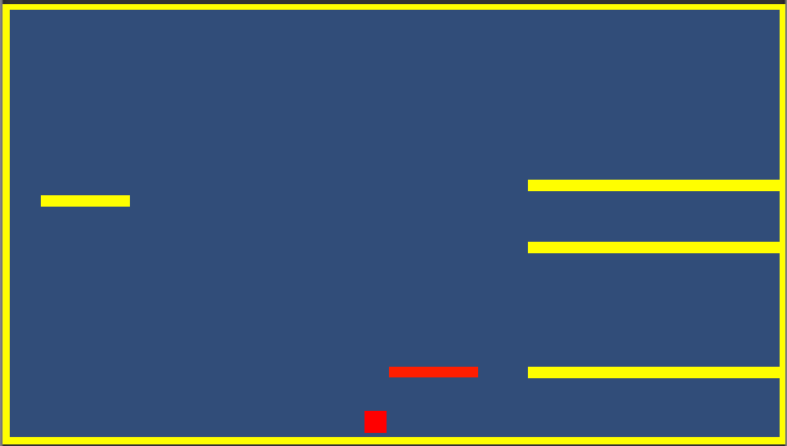
Animating and choreographing activities
Moving platforms revisited
04. Animated values
We don’t just have to animate transform attributes
Let’s animate the object colour
Add property
Platform_gfx.Mesh Renderer.Material._Color
Set some keys for it

Slide 21
Animating and choreographing activities
Moving platforms revisited
05. Callback events
We can also use the animation timeline to send events to scripts
This is really useful if you want to trigger game events within animations
To do this:
Add a new script to the moving_platform
Add a function public void OnEvent()
In the animation, ‘add event’ and select the function
If the event has an argument, you can pass this to the function from the animation event
Often, it makes sense to treat the animation as a loop rather than ping pong
As ping pong plays the animation forwards and backwards

Slide 22
Animating and choreographing activities
Moving platforms revisited
06. instancing animations
When we create animating objects ‘normally’ we have to remember that they are created in world space
This means, if I duplicate an animating object and move it, it will still animate in the same position
To get round this issue, if we create animations inside a parent object, the animating object will be in local space
This means we can paste it all over the place and it will animate relative to its parent
Obviously, these instance will share the same animation data (keyframes), so if you change the keyframes of one anim, you’ll see changes in all the animations that use that animation

Slide 23
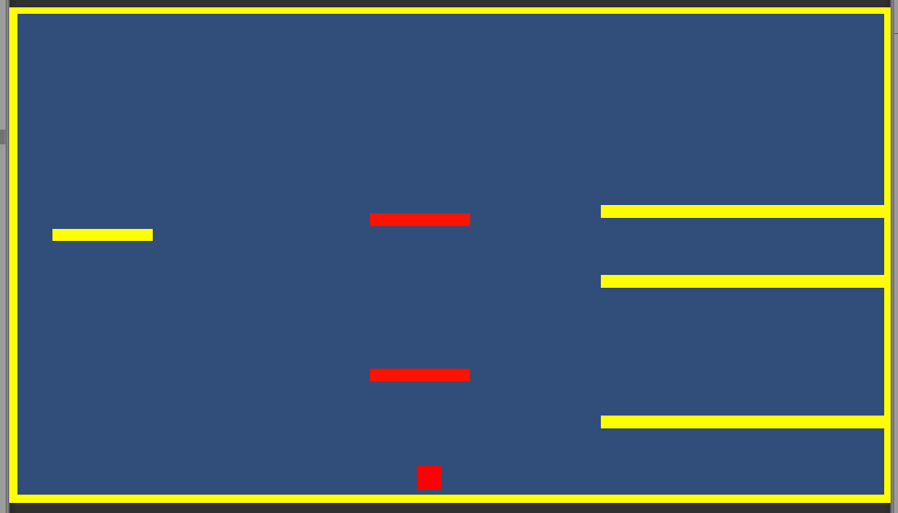
Animating and choreographing activities
Moving platforms revisited
06. instancing animations
Ideally, create the animation as a child of a parent, but you can also take an existing animation and drop it into a parent gameobject for the same effect
Root of object will be a bit off though

Slide 24
Animating and choreographing activities
Moving platforms revisited
07. Offset instances
We can use animation instances to great effect if we want to have lots of things doing the same thing
However, generally you want them to doing things slightly differently
We can use the animation’s offset to control where in an animation timeline an animation starts
This is parametric, so goes between 0 (start) and 1 (end)
Create a script that will expose this value and set it when the game starts

Slide 25
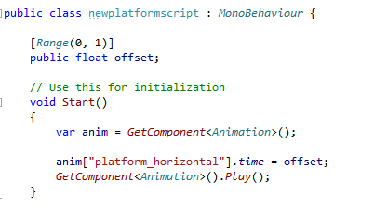
Animating and choreographing activities
Moving platforms revisited
07. Offset instances
Give each instance an offset and use that to set the time of the currently playing animation when the script starts

Slide 26
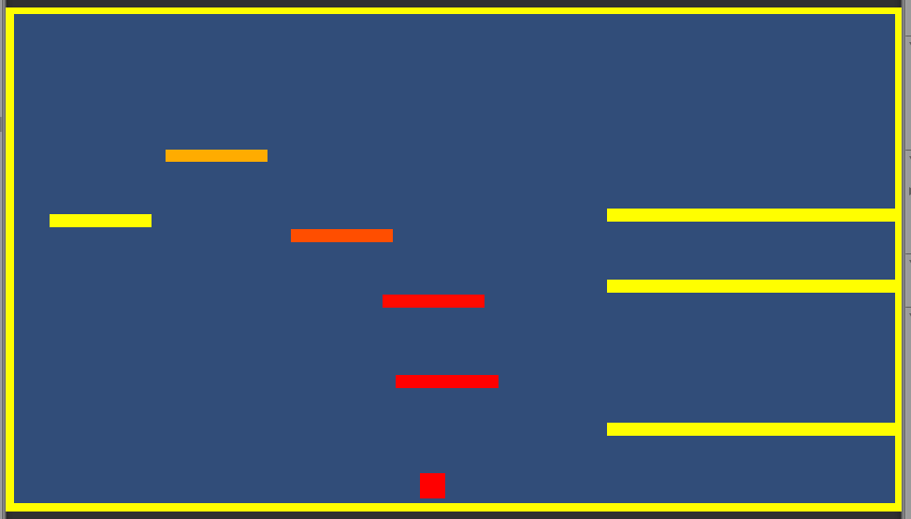
Animating and choreographing activities
Moving platforms revisited
07. Offset instances

Slide 27
Animating and choreographing activities
Moving platforms revisited
08. Animations as states
So far, we’ve looked at single animations to ‘do stuff’
What if we want animations to be dependent on what the player is doing?
Opening doors, reacting to trigger events etc

Slide 28
Animating and choreographing activities
Moving platforms revisited
08. Animations as states
We can think of an object having several states of operation that are realised through different animations
Therefore, we need a way to change animations based on the state of the game
An animation component can have several animations, all set in its animations list
Animations can be set with Play()

Slide 29
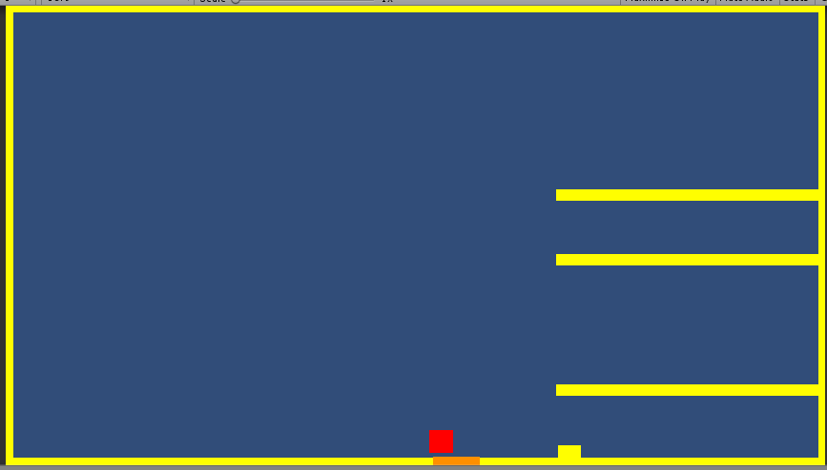
Animating and choreographing activities
Moving platforms revisited
08. Animations as states
Let’s set up a system where:
There’s a door
And it’s closed unless the player walks on a trigger
When the player walks on the trigger, it opens up
Once it’s open, it will stay open while the player is on the trigger
When the player leaves the trigger, it will close

Slide 30
Animating and choreographing activities
Moving platforms revisited
08. Animations as states
Effectively, we have a system with four states for the door
Closed
Open
Closed to open
Open to closed

Slide 31
Animating and choreographing activities
Moving platforms revisited
08. Animations as states
And some transitions
Closed
Open
Player on trigger
Player off trigger
Closed to open
Open to closed

Slide 32
Animating and choreographing activities
Moving platforms revisited
08. Animations as states
We need to be a little bit careful with construction ..
The door will open and close using a parent scale (like we looked at in week 2)
However, if the door trigger is part of that parent, it will scale with the door
We don’t want this as it will give rubbish results
So, we have a parent that contains the overall door effect
One child is the door trigger
The other child is the door gfx

Slide 33
Animating and choreographing activities
Moving platforms revisited
08. Animations as states
So, we have a parent that contains the overall door effect
One child is the door trigger
The other child is the door gfx
This will contain the animation component
Which means the other game objects will need to communicate through scripts

Slide 34
Animating and choreographing activities
Moving platforms revisited
08. Animations as states
So, we have a parent that contains the overall door effect
One child is the door trigger
This object will need to tell its parent when the player is in and out of its trigger
The other child is the door gfx
This object will need to tell its parent when an animation ends
To do that, we put an event at the end of each animation and pass the name of the animation in the event

Slide 35
Animating and choreographing activities
Moving platforms revisited
08. Animations as states
The parent will work out what to do when it gets told about the end of each animation, based on the state machine earlier
Currently, the player can become trapped in the nook behind the door.
We can ‘fix’ this by adding a trigger to the floor of the nook to stop the door from closing
Or, adding another trap into the nook to kill the player (lake of death, pit of death, something of death etc)
We could just make the door open and never close
We can also make the door open based on something else
This is your lock and key gameplay!

Slide 36
Break!

Slide 37
Unity UI

Slide 38
Unity UI
Unity has a very nice UI system that encapsulates all of the features seen in other parts of Unity
Hierarchical
Component based
Extensible with scripts ☺
WYSIWYG layout [hierarchy RMB->UI]
Prefab-able
In a different co-ordinate space to the game
Use the game view to place UI components into the game world

Slide 39
Unity UI
Add text
UI->Text will add a new text object & create a Canvas if one doesn’t exist
All UI lives in the canvas
Default font setup is:
Small, grey and sets overflows
So will be hard to see
So
Set overflows to overflow, else it’s easy for the font to clip out ;)
Make the font big enough to read
And make it not grey so you can see it
Add a drop shadow to make it stand out more
Fonts are truetype and any truetype will work
Goto https://fonts.google.com/ for a large selection of royalty free fonts
Select & download -> copy into assets folder
Select font

Slide 40
Unity UI
Add text
Reference from script
Use GameObject.Find to get the UI component you want
And get the component
Here, I’m printing the position of the player using ToString() to create a string from any object

Slide 41
Unity UI
Add Images
Unity will import most image formats (png, jpg etc)
In 2D mode, images will be converted to sprites
In 3D mode, images will be converted to textures
UI system requires sprites
So in 3D mode, you’ll need to convert them manually
Use preserve aspect to make the image sensible
And scale as required
Or use set native size

Slide 42
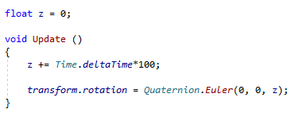
Unity UI
Transform components
Can use transform or RectTransform components
Can be a bit problematic, particularly with rotations, gimbal lock and quaternions
https://docs.unity3d.com/Manual/QuaternionAndEulerRotationsInUnity.html

Slide 43
Unity UI
Transform components
UI system is generally very good
Does do some weird things under the hood
Don’t be surprised if you get some strange outcomes

Slide 44
Prototypes into standalone games

Slide 45
Prototypes into standalone games
What we’ve been looking at so far on the module is making prototypes
One or two scenes that run in the editor
Fast to develop, test and debug
Obviously, people playing games want to have real products to play, so what’s the difference

Slide 46
Prototypes into standalone games
Obviously, people playing games want to have real products to play, so what’s the difference
Beginning
Middle
End
Beginning: players need to know what they need to do before the game play starts
Middle: the game experience
Our multiple scenes of game levels
End: when the player dies or wins and the game takes the player back to the beginning for the next experience

Slide 47
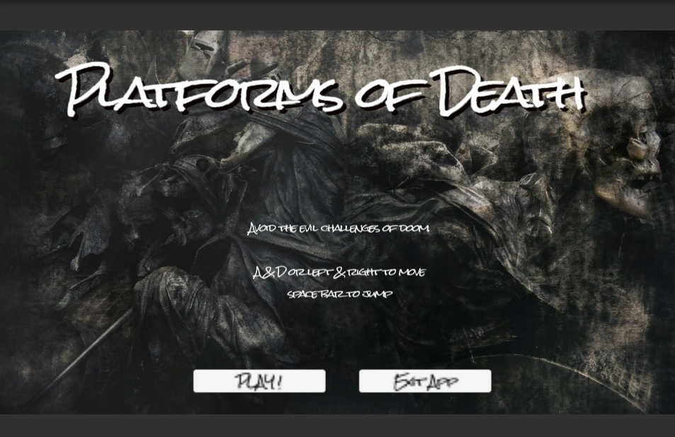
Prototypes into standalone games
Making the game
10.Game wrapper

Slide 48
Prototypes into standalone games
Making the game
10.Game wrapper
This is a game with 3 scenes:
Wrapper
What the player sees when the game loads
Play or quit options
Description of how to play the game
Implemented as UI
Level1
A level of real gameplay
On death, the game goes to the youdied screen
Youdied
Replay the game level
Or quit to the menu

Slide 49
Prototypes into standalone games
Making the game
For each scene, go into Edit->Build Settings and add the scene to the scenes in build
Run the beginning scene and press the buttons and/or die when playing the game
Quit
wrapper
Play Game
level1
Died
youdied
Quit
Exit
Replay

Slide 50
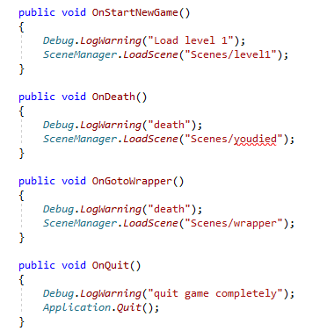
Prototypes into standalone games
Making the game
Each scene references a gamecontroller which contains a script for handling all the transitions
These are called from either:
Scripts
UI buttons
Buttons have an ‘OnClick’ event for calling script functions
Share the gameobject between scenes to reduce duplication of code (and errors)
Tweak the UI to stop the mouse from working
See gazStandaloneInputModule.cs
See also canvasglue.cs

Slide 51
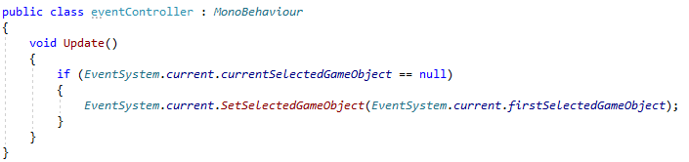
Prototypes into standalone games
Making the game
Let’s make the buttons work nicely
By default they use the mouse and keyboard
And support ‘navigation’ so up, down, left & right makes sense
let’s disable mouse support
Go into Canvas and disable ‘graphic Raycaster’
In the Event System, select a button to be first selected
Add this functionality to the EventSystem as a script

Slide 52
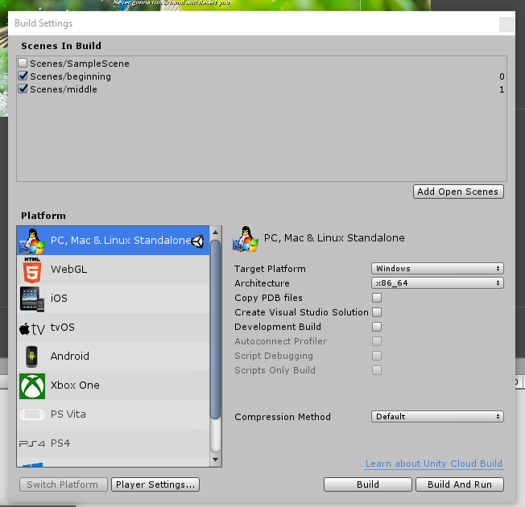
Prototypes into standalone games
Making the game
For each scene, go into Edit->Build Settings and add the scene to the scenes in build
Run the beginning scene and press the buttons
NB:
Can’t quit from unity editor

Slide 53
Prototypes into standalone games
Link it all together
Prototype game should be more like a proper game now ☺

Slide 54
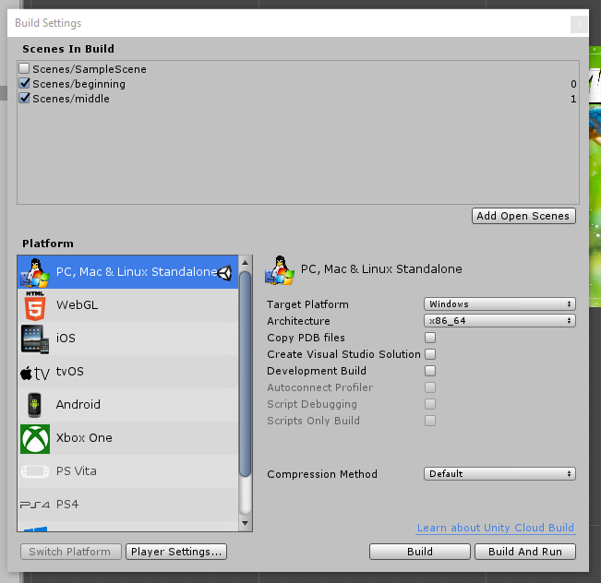
Prototypes into standalone games
Making a game build
Edit->Build Settings
Choose ‘PC’ as your target and press build
And select a folder ...

Slide 55
Prototypes into standalone games
Making a game build
Everything should build and you can launch the exe

Slide 56
Prototypes into standalone games
To improve the build
Make sure you are only making builds for the aspect ratios you want to support (normally 16:9)
Player Settings ->Resolution & Presentation -> Supported Aspect Ratios
Set to 16x9
In your canvas, set the canvas scaler to ‘scale with screen size’
Set the screen size to 1920x1080
Do this for all scenes ;)
Rebuild
Sometimes, there’s not 100% accuracy between editor and build
Check early, check often!

Slide 57
Conclusions

Slide 58
Conclusions
Unity’s animation systems give you a lot of scope to animate in Unity
Need to match your goals with suitable animation system
Hint, animation component should give you enough flexibility for what you want to do in the assignment
From my experience:
Designers tend to really like keyframing
Programmers don’t

Slide 59
Conclusions
Unity’s UI system
Imho, this is one of the strongest components of Unity
I’ve used it a lot to make v. complex UI projects and its worked really well
Like all things unity, the devil is in the detail, so watch out
Like all things unity, strange things do happen from time to time!

Slide 60
Conclusions
Prototypes into standalone games
Turning a prototype into a standalone game is a key development activity
Being able to give someone a build rather than a project is a huge achievement
Like all projects, it takes some finessing to convert a prototype into a build
It’s not completely a handle-cranking exercise
Budget time for this
Spend some time QA-ing your builds
Look at different resolutions & windowed / full-screen
Make sure you go over the UI
Make sure the game is displayed properly on the screen

Slide 61
Assignment Q&A

